Slide 1
Tips for Implementing OSLC Adapters
Axel Reichwein
March 24, 2016

Slide 2
Model-driven Development of OSLC Adapters
Automatically creating code and RDF resources based on a common domain-specific metamodel
Java classes with OSLC4J annotations for serializing POJOs into RDF/XML, JSON
Domain-specific API to parse XMI models
OSLC resource shapes
RDF Vocabulary

Slide 3
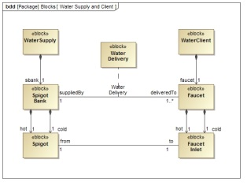
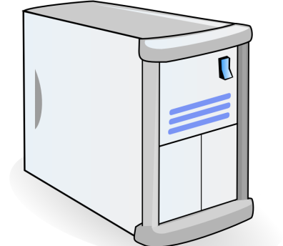

General Overview of OSLC Adapter
HTTP
OSLC Resource in RDF
OSLC Adapter
for Tool A
Resource in Tool A

Slide 4
OSLC Adapter Implemented in Java
HTTP
OSLC Resource in RDF
OSLC Adapter
for Tool A
Resource in Tool A
RESTful Web Services of OSLC adapter implemented in Java using
JAX-RS (Java API for RESTful Web Services) as in the OSLC adapters available from Eclipse Lyo

Slide 5
Converting Java Objects into OSLC Resources in RDF/XML
Assumption: Tool has Java API
HTTP
OSLC Resource in RDF
OSLC Adapter
for Tool A
Resource in Tool A
OSLC
Resources in RDF/XML or JSON
Tool-specific Java objects
Java objects with OSLC annotations
Conversion by OSLC adapter
Automatic conversion from POJO to RDF/XML or JSON by OSLC4J
Annotation Processing Tool

Slide 6
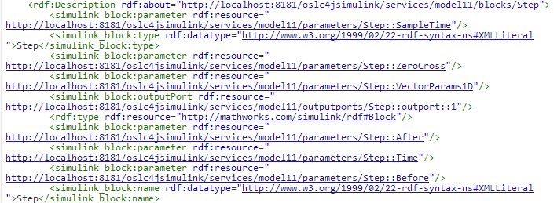
Example OSLC Resource in RDF/XML
OSLC Resource in RDF/XML With URI: http://localhost:8181/oslc4jsimulink/services/model11/blocks/Step
Just a snippet

Slide 7
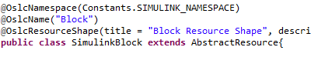
OSLC4J Example
OSLC Java classes
instance of
OSLC
Resources in RDF/XML or JSON
Tool-specific Java objects
Java objects with OSLC annotations
Conversion by OSLC adapter
Automatic conversion from POJO to RDF/XML or JSON by OSLC4J
Annotation Processing Tool

Slide 8
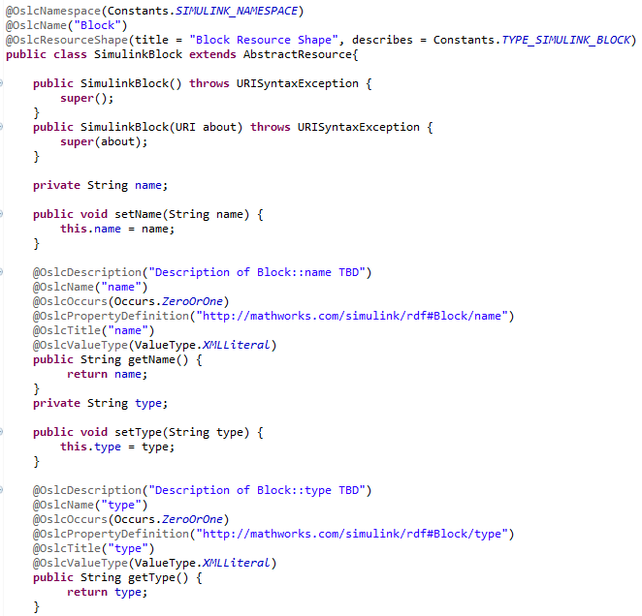
Example Java Class with OSLC4J Annotations
Manually programming OSLC Java classes is time-consuming and error-prone

Slide 9
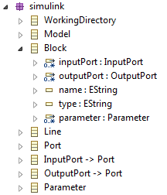
Model-driven Generation of OSLC-annotated Java Classes
Frequent changes
Metamodel
Based on
Automatic Generation
Java classes need to be updated based on metamodel
OSLC-annotated Java classes
instance of
OSLC
Resources in RDF/XML or JSON
Tool-specific Java objects
Java objects with OSLC annotations
Conversion by OSLC adapter
Automatic conversion from POJO to RDF/XML or JSON by OSLC4J
Annotation Processing Tool

Slide 10
Converting Java Objects into OSLC Resources in RDF/XML
Assumption: Tool has NO Java API
HTTP
OSLC Resource in RDF
OSLC Adapter
for Tool A
Resource in Tool A
OSLC
Resources in RDF/XML or JSON
Java objects with OSLC annotations
Tool-specific data
Intermediate XMI file
Conversion by tool API
Conversion by XMI parser

Slide 11
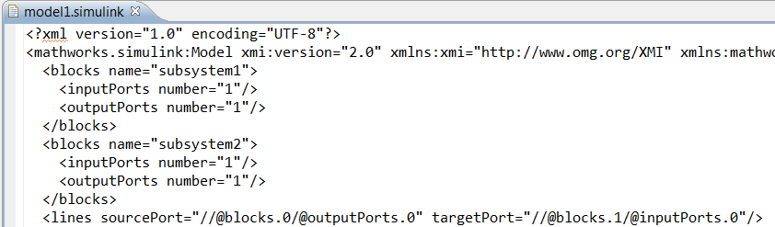
Example Intermediate XMI File

Slide 12
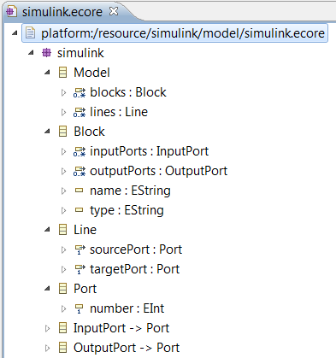
XML Schema of XMI File
XMI file needs to be parsed easily!
XMI file parser can be generated with EMF based on Simulink Ecore metamodel
XML Schema of XMI File defined as Ecore metamodel
conformsTo

Slide 13
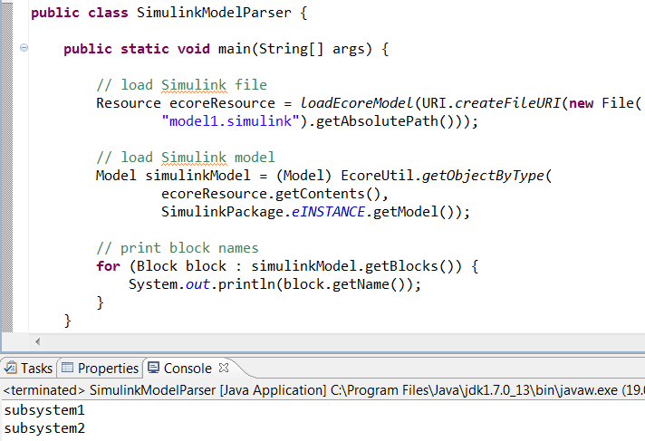
Generation of Domain-specific API
Metamodel in EMF
Generation of Java code to parse corresponding XMI file
Results

Slide 14
General Overview of RDF Resources for OSLC Data Interchange
RDF Vocabulary
in RDFS
OSLC Resource Shape defined in OSLC Core Vocabulary
refers_to
conforms_to
OSLC Resource in RDF
Resource in Tool A
Resource in Tool B
HTTP
OSLC Adapter
for Tool A
OSLC Adapter
for Tool B
Tool A
Tool B

Slide 15
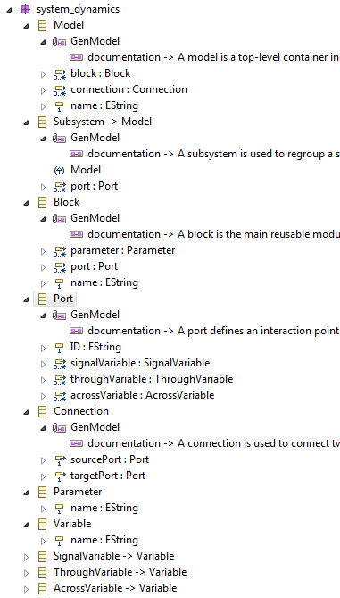
Conversion of Ecore Metamodel to RDF Resources of corresponding OSLC Specification

Slide 16
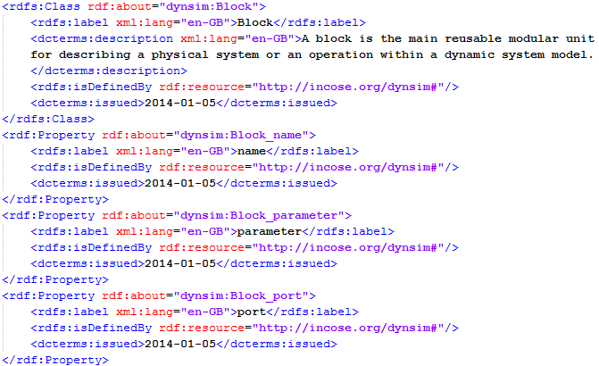
Conversion of Ecore Metaclass and Features into RDFS Class and RDF properties
Reuse of Dublin Core Vocabulary
Namespace URI
of RDF Vocabulary

Slide 17
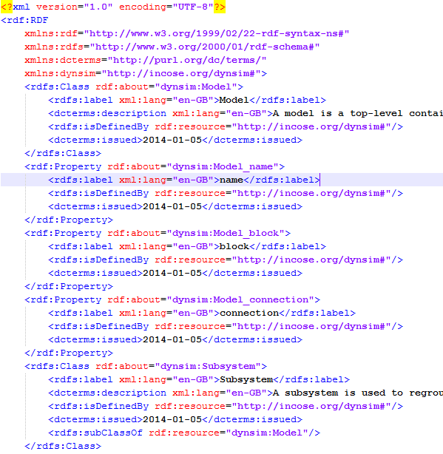
RDF Vocabulary for Dynamic Simulation Domain
RDF Vocabulary Namespace prefix and URI
RDFS Classes and RDF Properties are defined within an RDF Vocabulary
Just a snippet...

Slide 18
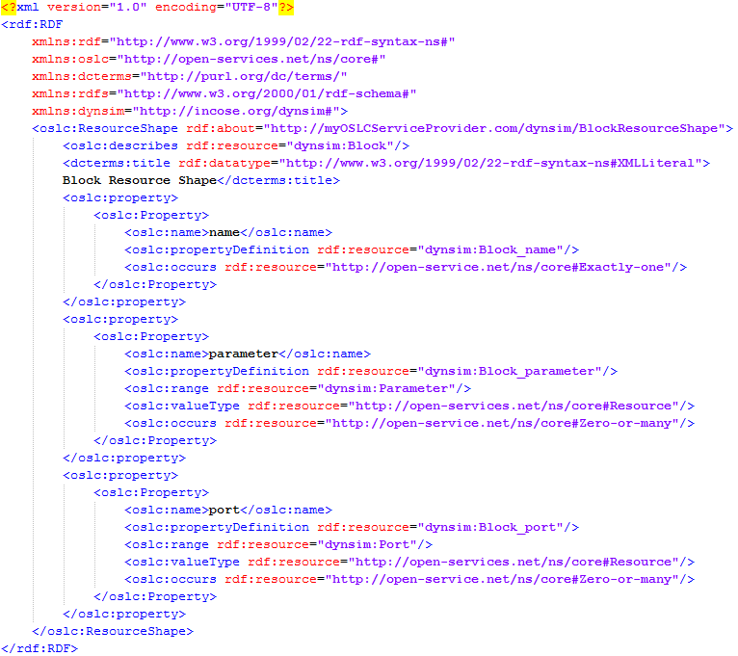
Conversion of Ecore Metaclass and Features into OSLC Resource Shape
Property names and multiplicities are converted into OSLC resource shape constraints

